Slide 1
Object Oriented Programming
Week 3
Abeer GAUHER
Email: abeer.gauher@nu.edu.pk
Office: CS BASEMENT 2, Office number 17

Slide 2
Introduction
A class is a data type.
Before we introduce classes, we will first present structures (also known as structs).
When used in the way we present them here, a structure is a kind of simplified class and structures will prove to be a stepping-stone to understanding classes.

Slide 3
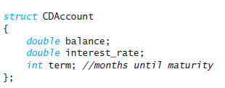
Structs
The keyword struct announces that this is a structure type definition.
The identifier CDAccount is the name of the structure type.
The name of a structure type is called the structure tag.
The identifiers declared inside the braces, {}, are called member names.
A structure type definition ends with both a brace, }, and a semicolon.
A structure definition is usually placed outside of any function definition.

Slide 4
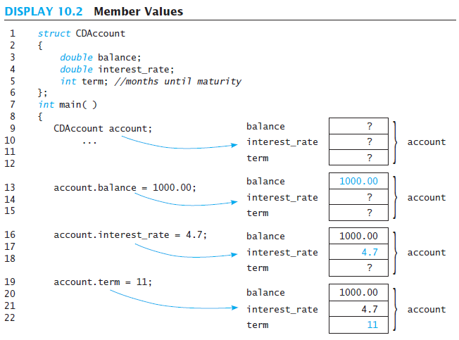
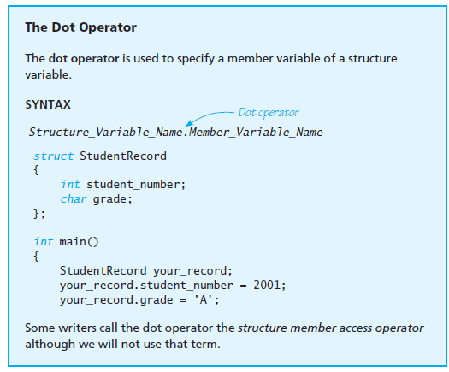
Structs

Slide 5
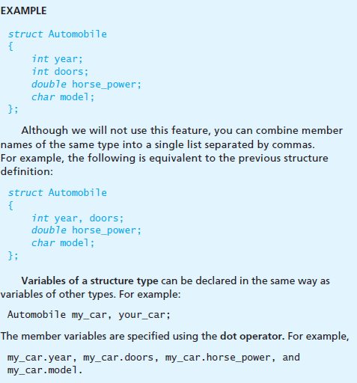
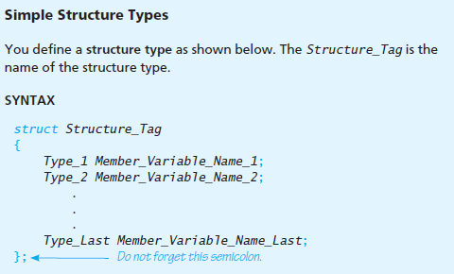
Structs

Slide 6
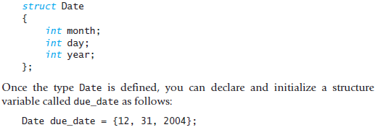
Structs
Initializing Structures
Initializing values must be given in the order that corresponds to the order of member variables in the structure type definition.
In this example, due_date.month receives the first initializing value of 12,
due_date.day receives the second value of 31, and due_date.year receives the third value of 2004.
It is an error if there are more initializers than struct members.

Slide 7
Classes and Objects
Defining Classes and Member Functions
A class is a data type whose variables are objects.
An object as a variable that has member functions as well as the ability to hold data values.
Within a C++ program, the definition of a class should be a data type definition that describes what kinds of values the variables can hold and also what the member functions are.
A structure definition describes some of these things.
A structure is a defined type that allows you to define values of the structure type by defining member variables.

Slide 8
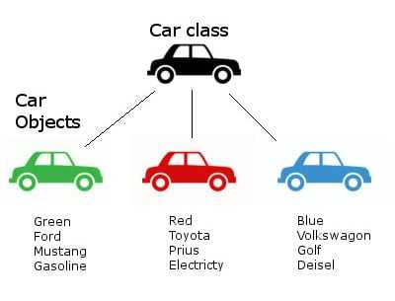
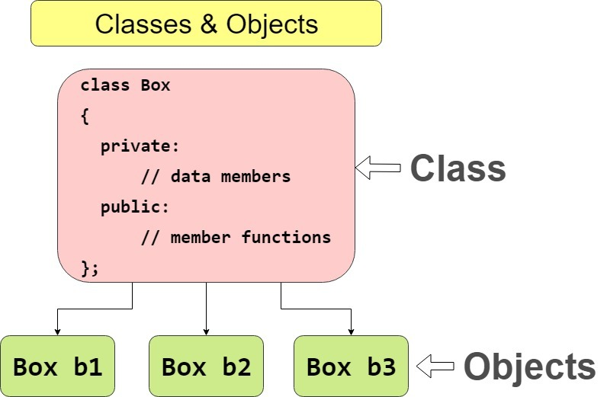
Classes and Objects
Defining Classes and Member Functions

Slide 9
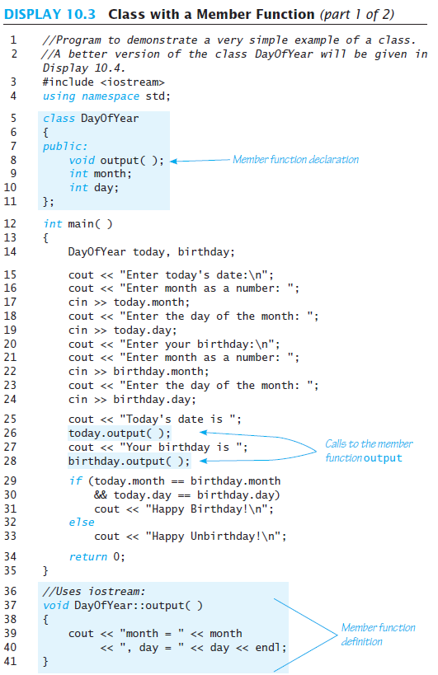
Classes and Objects
The type DayOfYear defined there is a class definition for objects whose values are dates, such as January 1 or July 4.
The class DayOfYear has one member function called output, which has no arguments and outputs the month and day values to the screen.
Objects (that is, variables) of a class type are declared in the same way as variables of the predefined types and in the same way as structure variables.

Slide 10
Classes and Objects
The program declares two objects of type DayOfYear in the following way:
DayOfYear today, birthday;
The member function output is called with the object today as follows:
today.output();
and the member function output is called with the object birthday as follows:
birthday.output();

Slide 11

Classes and Objects
When a member function is defined, the definition must include the class name because there may be two or more classes that have member functions with the same name.
The definition is similar to an ordinary function definition, but there are some differences.
The heading of the function definition for the member function output is as follows:

Slide 12
Classes and Objects
The operator :: is called the scope resolution operator.
The scope resolution operator :: is used with a class name, whereas the dot operator is used with objects.
The scope resolution operator consists of two colons with no space between them.

Slide 13
Classes and Objects
In the function definition of DayOfYear::output, we used the member names month and day by themselves without first giving the object and dot operator.
When the member function is called, as in today.output();
all the member names in the function definition are specialized to the name of the calling object. So the function call above is equivalent to the following:
{
cout << "month = " << today.month
<< ", day = " << today.day << endl;
}

Slide 14
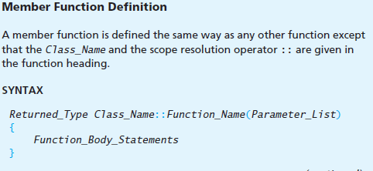
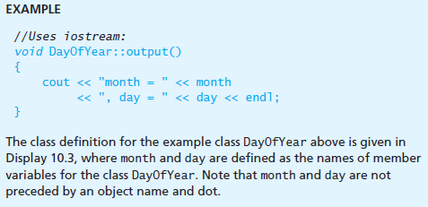
Classes and Objects

Slide 15
Classes and Objects
The Dot Operator and the Scope Resolution Operator
Both the dot operator and the scope resolution operator are used with member names to specify what thing they are members of.
You have declared a class called DayOfYear and you declare an object called today as follows: DayOfYear today;
You use the dot operator to specify a member of the object today. For example, output is a member function for the class DayOfYear and the following function call will output the data values stored in the object today: today.output();
You use the scope resolution operator :: to specify the class name when giving the function definition for a member function.
For example, the heading of the function definition for the member function output would be as follows: void DayOfYear::output()

Slide 16
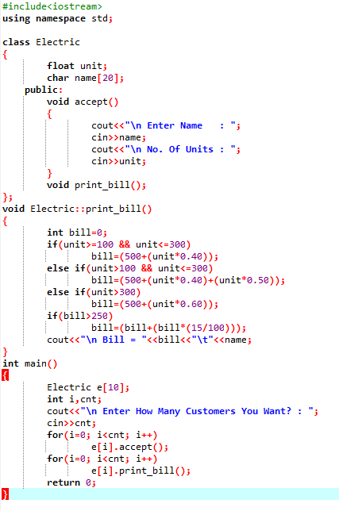
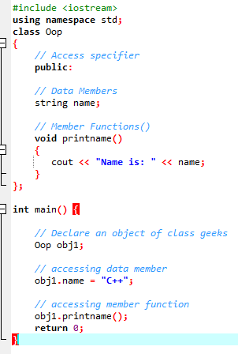
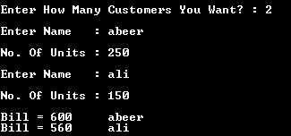
Classes and Objects

Slide 17
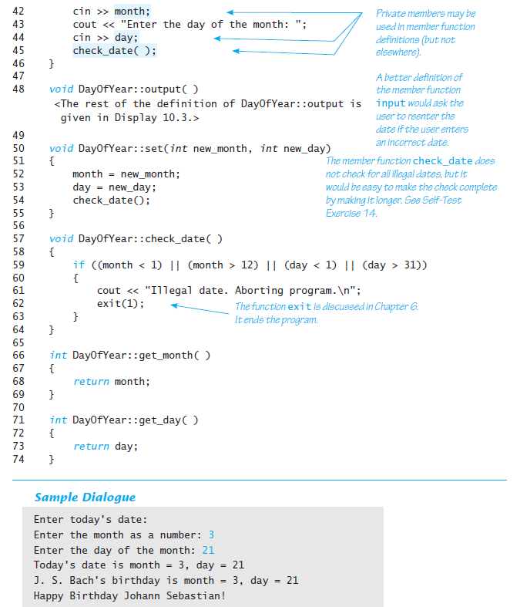
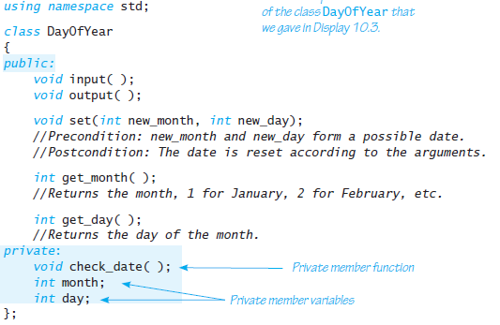
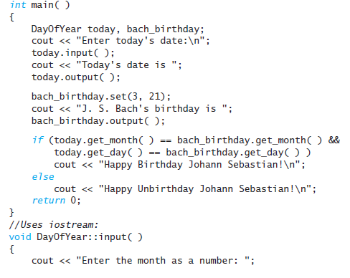
Access Control

Slide 18
Access Control
The line in the definition of the class DayOfYear that contains the keyword private.
All the member variable names that are listed after this line are private members, which means that they cannot be directly accessed in the program except within the definition of a member function.
If you try to access one of these member variables in the main part of your program or in the definition of some function that is not a member function of this particular class, the compiler will give you an error message.

Slide 19
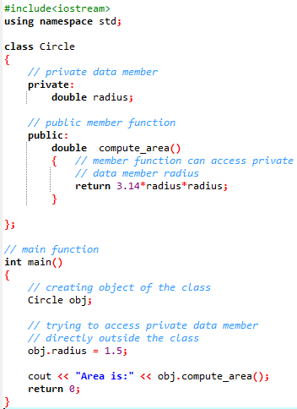
Access Control
ERROR
The output of above program is a compile time error because we are not allowed to access the private data members of a class directly outside the class.

Slide 20
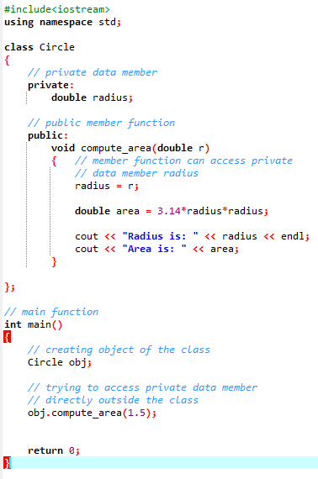

Access Control
We can access the private data members of a class indirectly using the public member functions of the class.

Slide 21
Access Control
For example, with this changed definition of the class DayOfYear, the following two assignments are no longer permitted in the main part of the program:
DayOfYear today; //This line is OK.
today.month = 12; //ILLEGAL
today.day = 25; //ILLEGAL
Any reference to these private variables is illegal (except in the definition of member functions).
The following are also illegal in the main part of any program that declares today to be of type DayOfYear:
cout << today.month; //ILLEGAL
cout << today.day; //ILLEGAL
if (today.month == 1) //ILLEGAL
cout << "January";

Slide 22
Access Control
It is also possible to make a member function private.
a private member function can be used in the definition of any other member function, but nowhere else, such as in the main part of a program that uses the class type.
For example, the member function DayOfYear::check_date in is a private member function.
The normal practice is to make a member function private if you only expect to use that member function as a helping function in the definitions of the member functions.

Slide 23
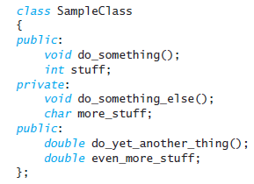
Access Control
The keyword public is used to indicate public members.
For example, for the class DayOfYear, all the member functions except DayOfYear::check_date are public members
A public member can be used in the main body of your program or in the definition of any function, even a nonmember function.

Slide 24
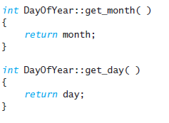
Accessors and Mutators
Member functions, such as get_month and get_day, that allow you to find out the values of the private member variables are called accessor functions.
Member functions that allow you to change the values of the private member variables are called mutator functions.
It is important to always include mutator functions with each class definition so that you can change the data stored in an object.

Slide 25
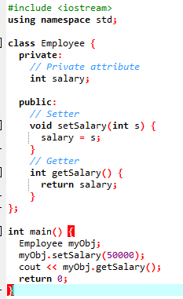
Accessors and Mutators
The salary attribute is private, which has restricted access.
The public setSalary() method takes a parameter (s) and assigns it to the salary attribute (salary = s).
The public getSalary() method returns the value of the private salary attribute.
Inside main(), we create an object of the Employee class. Now we can use the setSalary() method to set the value of the private attribute to 50000.
Then we call the getSalary() method on the object to return the value

Slide 26
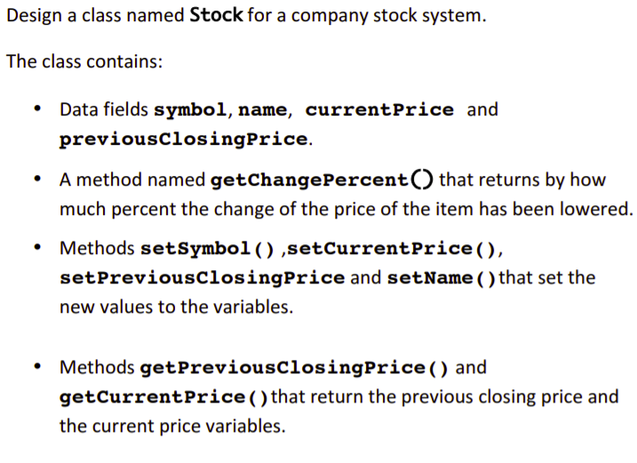

Slide 27
Constructors
Constructors for Initialization
A constructor is a member function that is automatically called when an object of that class is declared.
A constructor is used to initialize the values of member variables.
You can define a constructor the same way that you define any other member function, except for two points:
A constructor must have the same name as the class. For example, if the class is named BankAccount, then any constructor for this class must be named BankAccount.
A constructor definition cannot return a value. Moreover, no return type, not even void, can be given at the start of the function declaration or in the function header.

Slide 28
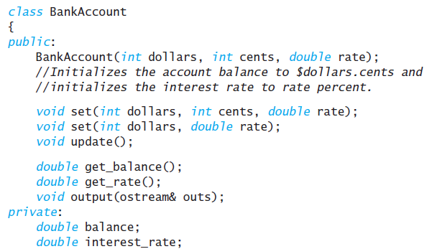
Constructors
Constructors for Initialization
Add a constructor for initializing the balance and interest rate for objects of type BankAccount.
Constructor is named BankAccount, which is the name of the class.
Function declaration for the constructor BankAccount does not start with void or with any other type.
The constructor is placed in the public section of the class definition.
If you were to make all your constructors private members, then you would not be able to declare any objects of that class type, which would make the class completely useless.

Slide 29

Constructors
Constructor cannot be called in the same way as an ordinary member function is called.
Declare the objects account1 and account2 as follows:
BankAccount account1(10, 50, 2.0), account2(500, 0, 4.5);

Slide 30
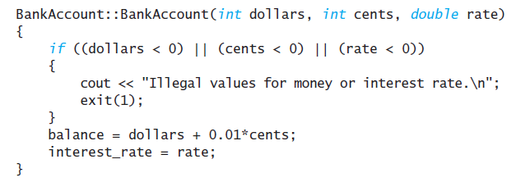
Constructors
Class and the constructor function have the same name.
The BankAccount before the scope resolution operator :: is the name of the class, and the BankAccount after the scope resolution operator is the name of the constructor function.
No return type is specified in the heading of the constructor definition, not even void.
Constructor can be defined in the same way as an ordinary member function.
Overload a constructor name like BankAccount::BankAccount so that it may have three arguments (as we just discussed), two arguments, or no arguments.

Slide 31
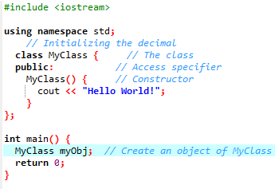
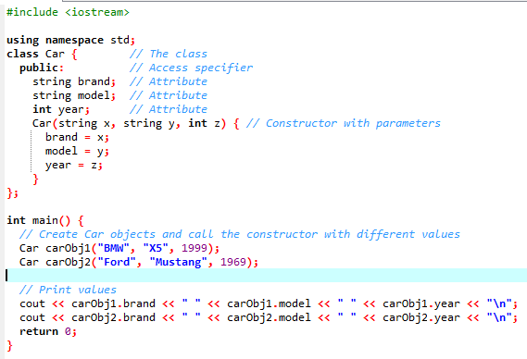

Constructors
No parameters
Constructor Parameters

Slide 32
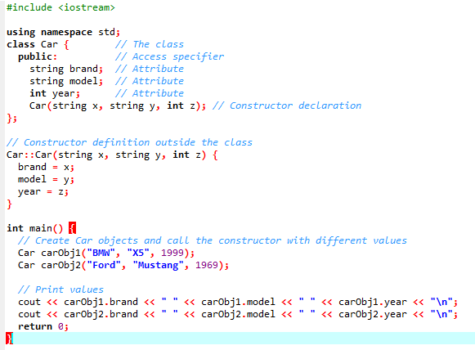

Constructors
Constructor Definition outside class

Slide 33
Types of Constructors
Default Constructor: Default constructor is the constructor which doesn’t take any argument. It has no parameters.
Parameterized Constructors: It is possible to pass arguments to constructors. Typically, these arguments help initialize an object when it is created.
Copy Constructor: A copy constructor is a member function which initializes an object using another object of the same class.

Slide 34
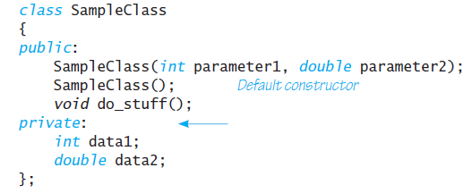
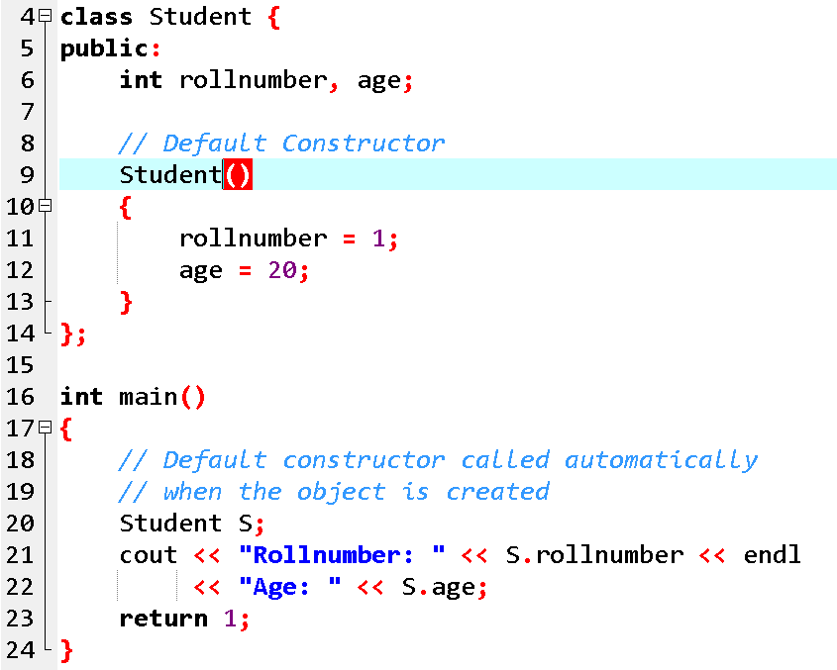
1. Default Constructor
Note: Even if we do not define any constructor explicitly, the compiler will automatically provide a default constructor implicitly.

Slide 35
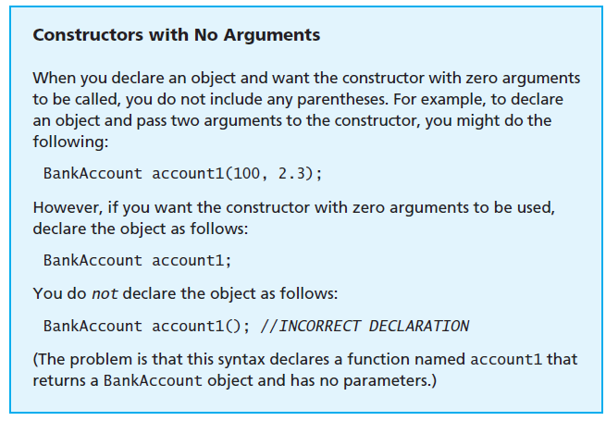
1. Default Constructor

Slide 36
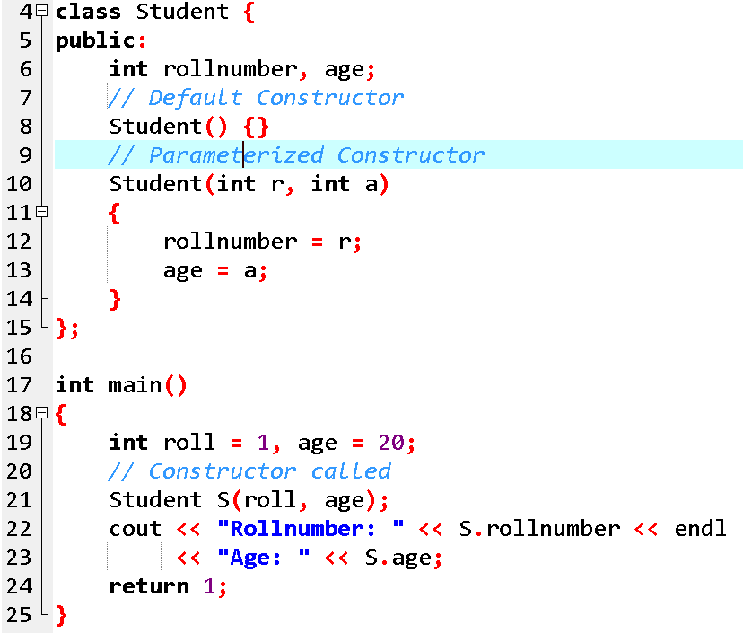
Parameterized Constructors
When an object is declared in a parameterized constructor, the initial values have to be passed as arguments to the constructor function. The normal way of object declaration may not work. The constructors can be called explicitly or implicitly.

Slide 37
2. Parameterized Constructors
Example e = Example(0, 50); // Explicit call
Example e(0, 50); // Implicit call
Uses of Parameterized constructor:
It is used to initialize the various data elements of different objects with different values when they are created.
It is used to overload constructors.
Can we have more than one constructors in a class? Yes, It is called Constructor Overloading.

Slide 38
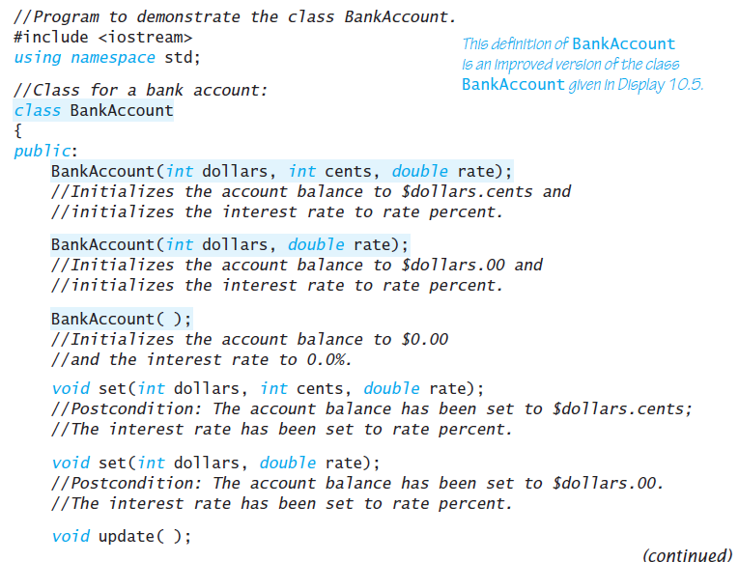
Constructors

Slide 39
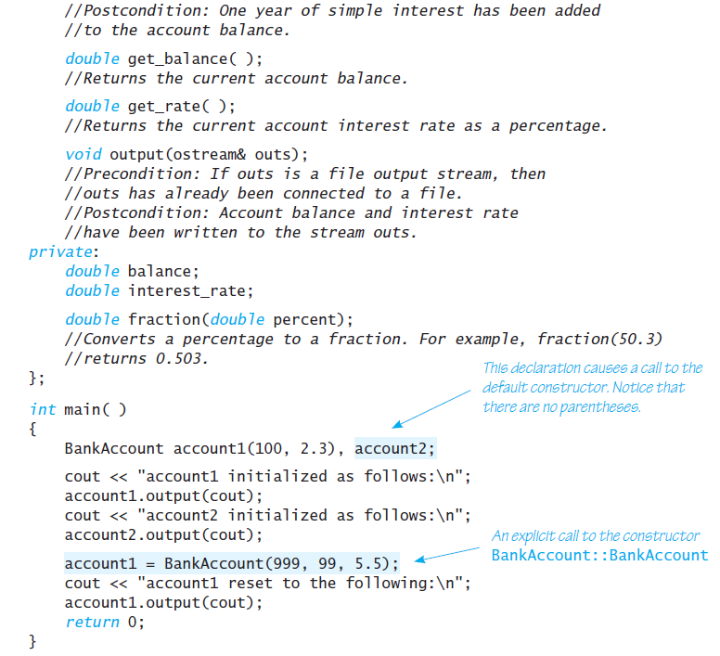
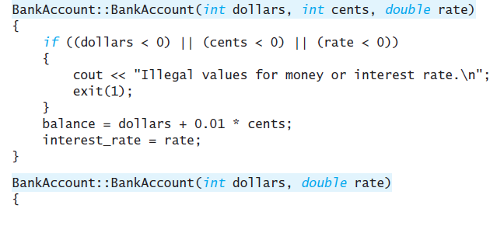
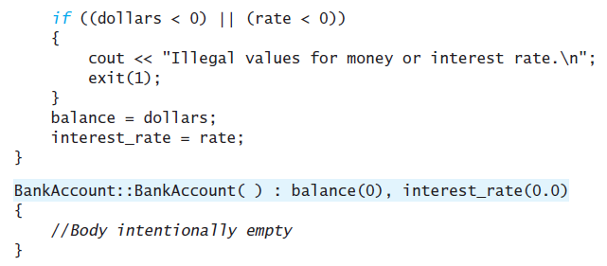
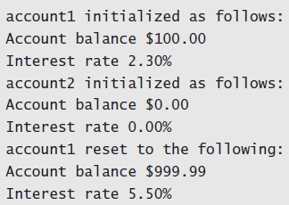
Constructors

Slide 40

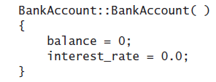
Constructors
The part that starts with a single colon is called the initialization section.
The initialization section goes after the parentheses that ends the parameter list and before the opening brace of the function body.
Each member variable is followed by its initializing value in parentheses

Slide 41
QUESTION TIME
Create an Account class to represent customers’ bank accounts. Include a data member of type int to represent the account balance.
You need to initialize the data members. But while doing so, you should validate the initial balance to ensure that it’s greater than or equal to 0. If not, set the balance to 0 and display an error message indicating that the initial balance was invalid.
Provide three member functions. Member function credit should add an amount to the current balance. Member function debit should withdraw money from the Account and ensure that the debit amount does not exceed the Account’s balance. If it does, the balance should be left unchanged and the function should print a message indicating "Debit amount exceeded account balance.“ Member function getBalance() should return the current balance. Create a program that creates two Account objects and tests the member functions of class Account.

Slide 42
Constructor Overloading in C++
Just like other member functions, constructors can also be overloaded. Infact when you have both default and parameterized constructors defined in your class you are having Overloaded Constructors, one with no parameter and other with parameter.
You can have any number of Constructors in a class that differ in parameter list.

Slide 43
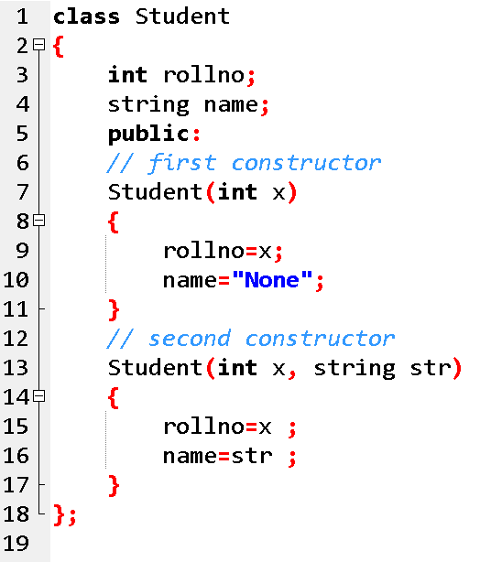
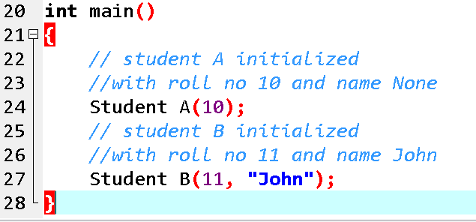

Slide 44
3. Copy Constructor
A copy constructor is a member function which initializes an object using another object of the same class.
A copy constructor has the following general function prototype:
ClassName (const ClassName &old_obj);

Slide 45
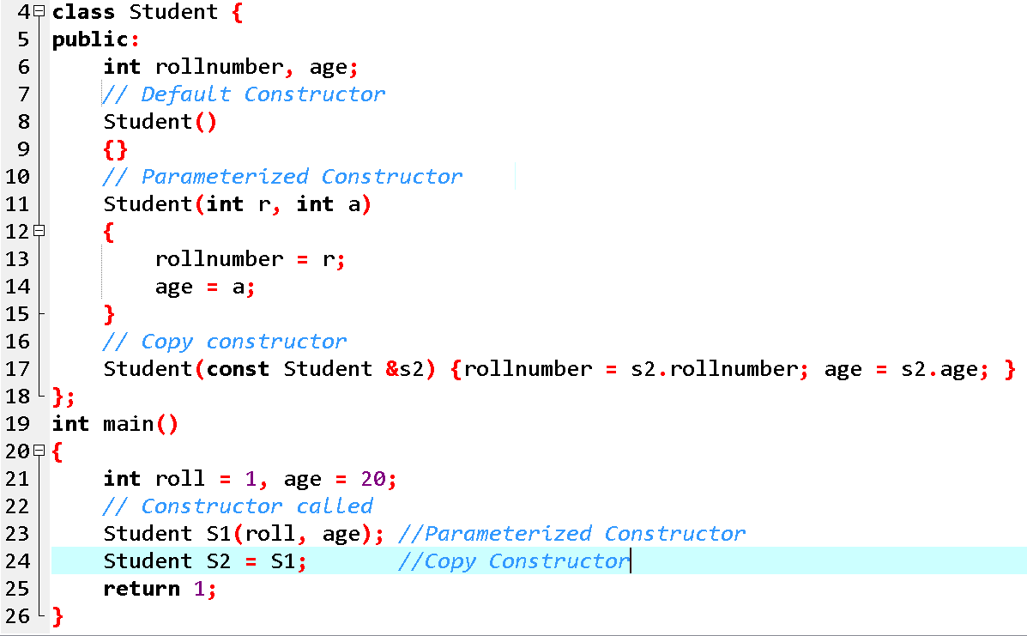
s

Slide 46
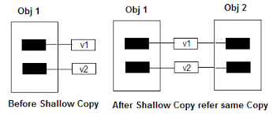
Shallow Copy Vs Deep Copy
Default constructor does only shallow copy.

Slide 47
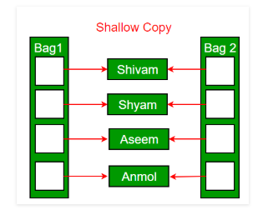
Shallow Copy Vs Deep Copy
Default constructor does only shallow copy.

Slide 48
Example
Student::Student(
const Student &obj){
rollNo = obj.rollNo;
name = obj.name;
GPA = obj.GPA;
}
int main(){
Student studentA;
Student studentB = studentA;
}

Slide 49
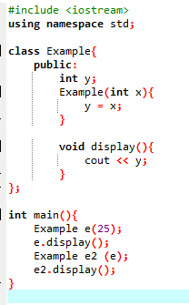
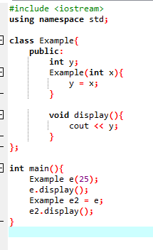
Default Copy Constructor

Slide 50
Shallow Copy
When we initialize one object with another then the compiler copies state of one object to the other
This kind of copying is called shallow copying

Slide 51
Example
Student studentA;
Student studentB = studentA;
Memory
studentA
studentB
A
H
M
A
D
…
Name
Name
RollNo
RollNo
GPA
GPA

Slide 52
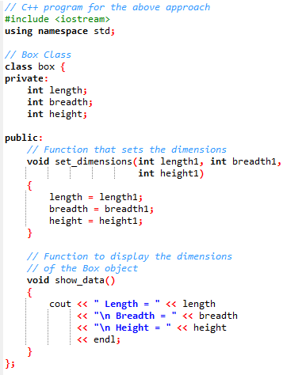
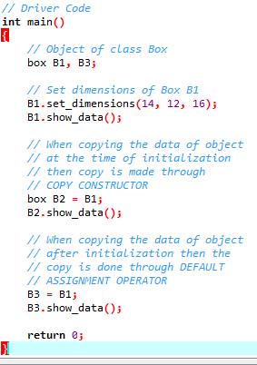
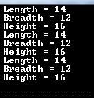

Slide 53
Copy Constructor (contd.)
Copy constructor is normally used to perform deep copy
If we do not make a copy constructor then the compiler performs shallow copy
Memory
A
A
H
M
A
D
Name
RollNo
GPA
B
Student studentA;
Student studentB = studentA;
A
H
M
A
D
Name
RollNo
GPA

Slide 54
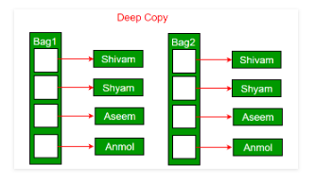
Shallow Copy Vs Deep Copy
Deep copy is possible only with user defined copy constructor. In user defined copy constructor, we make sure that pointers (or references) of copied object point to new memory locations.

Slide 55
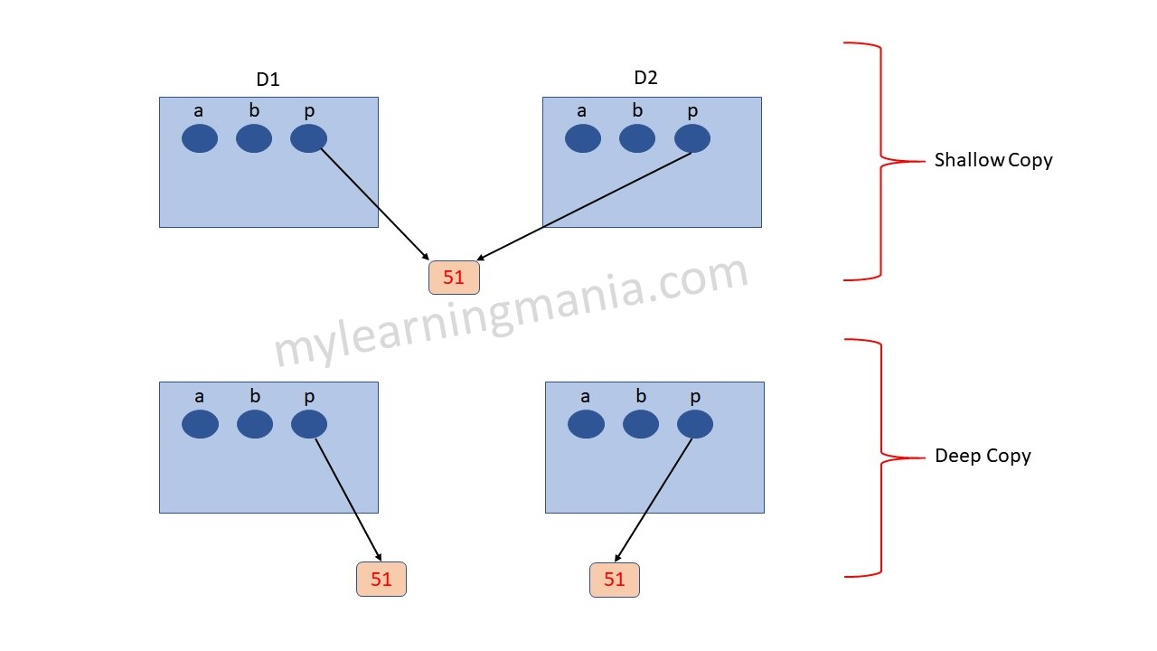
Shallow Copy Vs Deep Copy

Slide 56



Example SHALLOW COPY

Slide 57



Example DEEP COPY

Slide 58
QUESTION TIME
Create a class named 'Rectangle' with two data members- length and breadth and a function to calculate the area which is 'length*breadth'. The class has two constructors which are
Having no parameter - values of both length and breadth are assigned zero.
Having two numbers as parameters - the two numbers are assigned as length and breadth respectively.
Now, create objects of the 'Rectangle' class having none and two parameters and print their areas, also create copy constructor.

